Slide 1
Chapter 8: Relational Database Design

Slide 2
问题
数据库的逻辑设计问题
  给出一组数据，如何构造一个适合于它们的数据模式？
为什么研究关系数据理论？
  关系数据理论是关系数据库逻辑设计的工具
  关系模型有严格的数学理论基础

Slide 3
Chapter 8: Relational Database Design
8.1 Features of Good Relational Design
8.2 Atomic Domains and First Normal Form
8.3 Decomposition Using Functional Dependencies
8.4 Functional Dependency Theory
8.5 Algorithms for Functional Dependencies
8.6 Decomposition Using Multivalued Dependencies
8.7 More Normal Form
8.8 Database-Design Process
8.9 Modeling Temporal Data

Slide 4
关系模式的设计问题
示例
  设关系模式R(S#,C#,CName, TName) 属性分别为学生学号，选修课程号，课程名，教师姓名

Slide 5
关系模式的设计问题
  信息的不可表示问题
    插入异常：新开课程(C1,Alg,Zhang)，尚无学生选修时，如何将其插入；
    删除异常：删除学生信息时，课程信息会同时消除；
  信息的冗余问题
    数据冗余：对于多个学生选修的课程会多次重复；
    更新异常(复杂)：若一门课程的信息，如授课教师，发生修改，则更新操作复杂且可能引入不一致；
设关系模式R(S#,C#,CName, TName) 属性分别为学生学号，选修课程号，课程名，教师姓名

Slide 6
数据库的逻辑设计
“不好”的关系模式会存在问题
  不可表示：插入异常、删除异常
  冗余：数据冗余、更新复杂
原因
  属性间存在某种数据依赖
  范式：对关系的数据依赖程度的要求
  怎样找出所有的数据依赖并确定范式和码？
Armstrong公理系统（推理规则）
怎样消除不合适的数据依赖？
  模式分解
  分解的无损连接和保持依赖性

Slide 7

不良的模式设计
各种异常
部分函数依赖、传递函数依赖、多值依赖
不良的数据依赖
1NF、2NF、3NF、BCNF、4NF
范式
Armstrong公理、属性集的闭包、函数依赖的推导、候选码的计算、函数依赖集的等价和最小覆盖、
范式的判定
模式分解的定义、保持
函数依赖分解和保持无损连接分解的判定和分解算法
模式分解
良好的模式设计

Slide 8
范式之间的关系
1NF
消除非主属性对码的部分函数依赖
2NF
消除非主属性对码的传递函数依赖
3NF
消除主属性对码的部分函数依赖
BCNF
消除非平凡的多值依赖
4NF

Slide 9
Chapter 8: Relational Database Design
In this chapter, we consider the problem of designing a schema for a relational database. (关系数据库的设计模式)
Many of the issues in doing so are similar to design issues we considered in Chapter 7 using the E-R model.
In general, the goal of relational database design is to generate a set of relation schemas that allows us to store information without unnecessary redundancy, yet also allows us to retrieve information easily. (生成一组关系模式)
We introduce a formal approach to relational database design
based on the notion of functional dependencies. （基于函数依赖概念的规范方法）

Slide 10
8.1 Features of Good Relational Design
8.1.1 Design Alternative: Larger Schemas
8.1.2 Design Alternative: Smaller Schemas

Slide 11

Combine Schemas?
Suppose we combine instructor and department into inst_dept
  (No connection to relationship set inst_dept)
Result is possible repetition of information

Slide 12
8.1.1 Design Alternative: Larger Schemas
Even if we decided to live with the redundancy problem, there is still another problem with the inst dept schema. (不止只有冗余的问题)
Suppose we are creating a new department in the university. In the alternative design above, we cannot represent directly the information concerning a department (dept name, building, budget) unless that
department has at least one instructor at the university. （添加新系的情况）
This is because tuples in the inst dept table require values for ID, name, and salary. （需要教工信息）

Slide 13
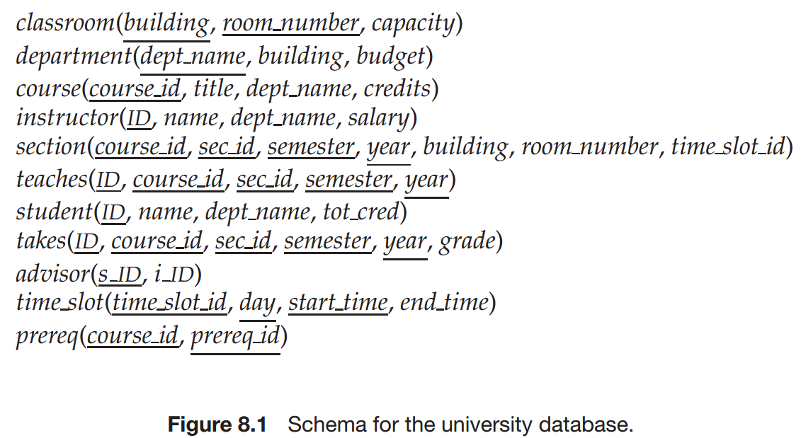
A Combined Schema Without Repetition
Consider combining relations
  sec_class(sec_id, building, room_number) and
  section(course_id, sec_id, semester, year)
  into one relation
  section(course_id, sec_id, semester, year,
  building, room_number)
No repetition in this case(不会产生冗余)

Slide 14
8.1.2 Design Alternative: Smaller Schemas
Suppose we had started with inst_dept. How would we know to split up (decompose) it into instructor and department?(如何发现信息重复且需拆分成两个模式？)
Write a rule “if there were a schema (dept_name, building, budget), then dept_name would be a candidate key”
Denote as a functional dependency: dept_name → building, budget
In inst_dept, because dept_name is not a candidate key, the building and budget of a department may have to be repeated.
  This indicates the need to decompose inst_dept
Not all decompositions are good. Suppose we decompose
employee(ID, name, street, city, salary) into
employee1 (ID, name)
employee2 (name, street, city, salary)
The next slide shows how we lose information -- we cannot reconstruct the original employee relation -- and so, this is a lossy decomposition（有损分解）.

Slide 15
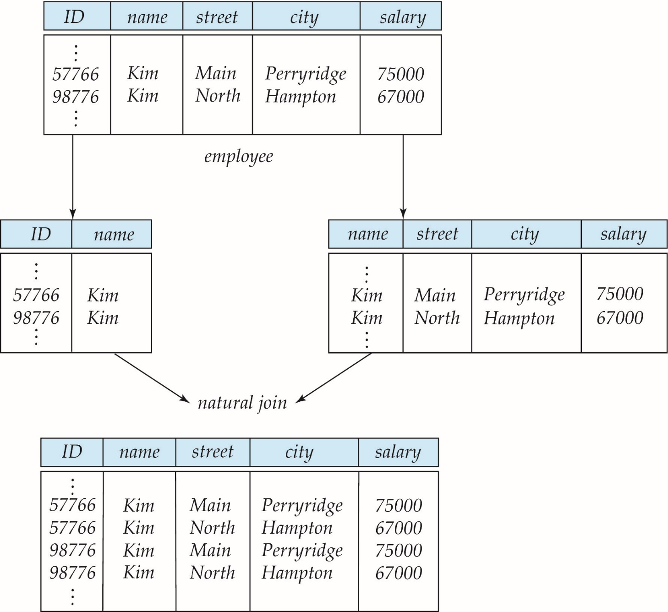
A Lossy Decomposition（有损分解）

Slide 16
8.2 Atomic Domains and First Normal Form
范式是符合某一种级别的关系模式的集合。
关系数据库中的关系必须满足一定的要求，满足不同程度要求的为不同范式。
目前关系数据库有六种范式：第一范式（1NF）、第二范式（2NF）、第三范式（3NF）、Boyce-Codd范式（BCNF）、第四范式（4NF）和第五范式（5NF）。
1NF
消除非主属性对码的部分函数依赖
2NF
消除非主属性对码的传递函数依赖
3NF
消除主属性对码的部分函数依赖
BCNF
消除非平凡的多值依赖
4NF

Slide 17
First Normal Form
Domain is atomic if its elements are considered to be indivisible units（如果一个域的元素是不可分的单元，则其是原子的）
  Examples of non-atomic domains:
    Set of names, composite attributes
    Identification numbers like CS101 that can be broken up into parts（问题：1.额外编程得到系名，2.换系的情况）
A relational schema R is in first normal form if the domains of all attributes of R are atomic（关系中每一分量不可再分。即不能以集合、序列等作为属性值）
Non-atomic values complicate storage and encourage redundant (repeated) storage of data
  Example: Set of accounts stored with each customer, and set of owners stored with each account
  We assume all relations are in first normal form (and revisit this in Chapter 22: Object Based Databases)

Slide 18
Goal — Devise a Theory for the Following
Decide whether a particular relation R is in “good” form.
In the case that a relation R is not in “good” form, decompose it into a set of relations {R₁, R₂, ..., R_{n}} such that
  each relation is in good form
  the decomposition is a lossless-join decomposition
Our theory is based on:
  functional dependencies（函数依赖）
  multivalued dependencies（多值依赖）

Slide 19
8.3 Decomposition Using Functional Dependencies（使用函数依赖进行分解）
In discussing algorithms for relational database design, we shall need to talk about arbitrary relations and their schema, rather than talking only about examples.（使用于任意关系及其模式）
8.3.1 Keys and Functional Dependencies
8.3.2 Boyce–Codd Normal Form
8.3.3 BCNF and Dependency Preservation
8.3.4 Third Normal Form
8.3.5 Higher Normal Forms

Slide 20
8.3.1 Keys and Functional Dependencies
A database models a set of entities and relationships in the real world. There are usually a variety of constraints (rules) on the data in the real world. （数据库：显示世界中实体和联系建模）
For example, some of the constraints（约束） that are expected to hold in a university database are:
1. Students and instructors are uniquely identified by their ID. (唯一标识)
2. Each student and instructor has only one name. (只有一个名字)
3. Each instructor and student is (primarily) associated with only one department. (（主要）关联一个系)
4. Each department has only one value for its budget, and only one associated building. (每个系只有一个预算，关联一个办公楼)
An instance of a relation that satisfies all such real-world constraints is called a legal instance（合法实例） of the relation; a legal instance of a database is one where all the relation instances（关系实例） are legal instances. →现实世界的约束可以形式化地表示为码（超、候、主），或者下面定义的函数依赖。

Slide 21
Functional Dependencies
Let R be a relation schema
α ⊆ R and β ⊆ R
The functional dependency（函数依赖）
α → β
holds on R if and only if for any legal relations r(R), whenever any two tuples t₁ and t₂ of r agree on the attributes α, they also agree on the attributes β.(对实例中的所有元组对) That is,
t₁[α] = t₂ [α] ⇒ t₁[β ] = t₂ [β ]
Example: Consider r(A,B ) with the following instance of r.
On this instance, A → B does NOT hold, but B → A does hold.
A
B
4
1 5
3 7
Notes:
自己写一个A到B成立

Slide 22
Functional Dependencies (Cont.)
K is a superkey for relation schema R if and only if K → R（R：属性集）
K is a candidate key for R if and only if
  K → R, and
  for no α ⊂ K, α → R
Functional dependencies allow us to express constraints that cannot be expressed using superkeys. （函数依赖能够表示不能用超码表示的约束）
Consider the schema:
inst_dept (ID, name, salary, dept_name, building, budget ).
We expect these functional dependencies to hold:
dept_name→ building
and ID → building

Slide 23
Use of Functional Dependencies
We use functional dependencies to:
  test relations to see if they are legal under a given set of functional dependencies. （判定关系的实例是否满足给定函数依赖F）
    If a relation r is legal under a set F of functional dependencies, we say that r satisfies F.
  specify constraints on the set of legal relations（说明合法关系集上的约束）
    We say that F holds on R if all legal relations on R satisfy the set of functional dependencies F.
Note: A specific instance of a relation schema may satisfy a functional dependency even if the functional dependency does not hold on all legal instances.
  For example, a specific instance of instructor may, by chance, satisfy
  name → ID.

Slide 24
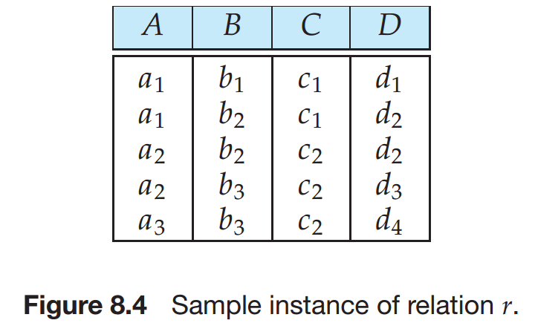
Observe that A → C is satisfied.
  There are two tuples that have an A value of a1. These tuples have the same C value—namely, c1.
  Similarly, the two tuples with an A value of a2 have the same C value, c2.
  There are no other pairs of distinct tuples that have the same A value.
The functional dependency C → A is not satisfied. Why?

Slide 25
Functional Dependencies (Cont.)
A functional dependency is trivial（平凡依赖） if it is satisfied by all instances of a relation
  Example:
    ID, name → ID
    name → name
  In general, α → β is trivial if β ⊆ α

Slide 26
Closure of a Set of Functional Dependencies
Given a set F of functional dependencies, there are certain other functional dependencies that are logically implied by F.(给定关系上成立的函数依赖集F，有可能会推断出某些其他的函数依赖也一定在该关系上成立)
  For example: If A → B and B → C, then we can infer that A → C
The set of all functional dependencies logically implied by F is the closure of F.(能够从给定F集合推导出的所有函数依赖的集合)
We denote the closure of F by F⁺.（F集合的闭包）
F⁺ is a superset of F.（ F⁺ 包含所有函数）

Slide 27
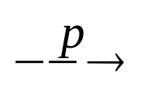
2NF
主属性：包含在任一候选码中的属性，称作主属性
定义
  若R∈1NF，且每个非主属性完全依赖于码，则称R∈2NF
  消除非主属性对码的部分依赖
  如S∉2NF，因为
  关系模式S(S# , SN , SD , DEAN , C# , G)
  （S#，C#） SN
  （S#，C#） SD

Slide 28
2NF
改造
  非主属性有两种，一种完全依赖于码，一种部分依赖于码。
  将S分解为：
  SC(S# , C# , G)
  S_SD(S# , SN , SD , DEAN)
练习
  关系模式R（A，B，C，D），码为AB，给出它的一个函数依赖集，使得R属于1NF而不属于2NF

Slide 29
8.3.2 Boyce-Codd Normal Form
A relation schema R is in BCNF with respect to a set F of functional dependencies if for all functional dependencies in F⁺ of the form α → β where α ⊆ R and β ⊆ R, at least one of the following holds:（具有函数依赖集F的关系模式R属于BCNF的条件是：对F⁺中所有函数依赖满足：1.平凡依赖，2.左侧为超码）
α → β is trivial (i.e., β ⊆ α)
α is a superkey for R
Example schema not in BCNF:
instr_dept (ID, name, salary, dept_name, building, budget )

Slide 30
8.3.2 Boyce-Codd Normal Form
A relation schema R is in BCNF with respect to a set F of functional dependencies if for all functional dependencies in F⁺ of the form α → β where α ⊆ R and β ⊆ R, at least one of the following holds:（具有函数依赖集F的关系模式R属于BCNF的条件是：对F⁺中所有函数依赖满足：1.平凡依赖，2.左侧为超码）
α → β is trivial (i.e., β ⊆ α)
α is a superkey for R
Example schema not in BCNF:
instr_dept (ID, name, salary, dept_name, building, budget )
because dept_name→ building, budget
holds on instr_dept, but dept_name is not a superkey

Slide 31
Decomposing a Schema into BCNF
Let R be a schema that is not in BCNF. Then there is at least one nontrivial functional dependency α → β such that α is not a superkey for R. （设R为不属于BCNF的一个模式，则存在至少一个非平凡的函数依赖 α → β ， α不是R的超码。）
Suppose we have a schema R and a non-trivial dependency α→β causes a violation of BCNF.
We decompose R into:
  (α U β )
  ( R - ( β - α ) )
In our example,
  α = dept_name
  β = building, budget
  and inst_dept is replaced by
  (αU β ) = ( dept_name, building, budget )
  ( R - ( β - α ) ) = ( ID, name, salary, dept_name )
instr_dept (ID, name, salary, dept_name, building, budget )

Slide 32
BCNF
思考
  (S# , C# , ORDER)，表示学生选修课程的名次，有函数依赖(S#，C#)→ ORDER， (C#，ORDER) → S#，它属于BCNF吗？
全码属于BCNF吗？
Notes:
?

Slide 33
8.3.3 BCNF and Dependency Preservation
We have seen several ways in which to express database consistency constraints: primary-key constraints, functional dependencies, check constraints, assertions, and triggers. （主码约束、函数依赖、check约束、断言、触发器）
Testing these constraints each time the database is updated can be
costly and, therefore, it is useful to design the database in a way that constraints can be tested efficiently. （每次数据库更新时检查这些约束的代价很大）
In some cases, decomposition into BCNF can prevent efficient testing of certain functional dependencies.(BCNF的分解有时会妨碍某些函数依赖的高效监测)

Slide 34

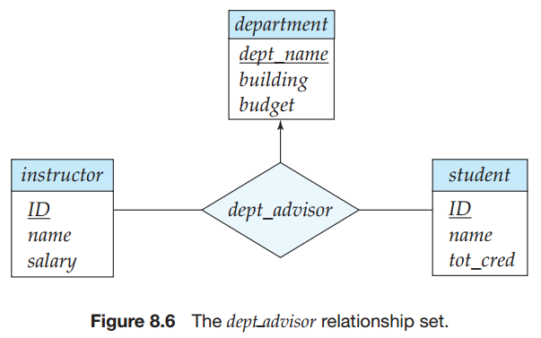


8.3.3 BCNF and Dependency Preservation
The E-R diagram specifies the constraint that “a student may have more than one advisor, but at most one corresponding to a given department”. （一个学生可以有多位导师，但是对应于一个给定的系最多只有一个&一个教师只能在一个系担任导师）
Dependencies
BCNF

Slide 35
8.3.4 Third Normal Form
A relation schema R is in third normal form (3NF) if for all:
α → β in F⁺
at least one of the following holds:
  α → β is trivial (i.e., β ∈ α)
  α is a superkey for R
  Each attribute A in β – α is contained in a candidate key for R.
  (NOTE: each attribute may be in a different candidate key-每个属性A都包含于R的一个候选码中)
If a relation is in BCNF it is in 3NF (since in BCNF one of the first two conditions above must hold).
Third condition is a minimal relaxation of BCNF to ensure dependency preservation (will see why later).（BCNF条件的最小放宽）

Slide 36


3NF
定义
  关系模式R< U , F >中，若不存在这样的码X，属性组Y及非主属性Z(Z Y)，使得下式成立，
  X→Y , Y→Z , Y→X
  则称R∈3NF
  消除非主属性对码的传递依赖
  如S_SD ∉3NF
  S_SD(S# , SN , SD , DEAN)

Slide 37
3NF
定义
  关系模式R< U , F >中，若不存在这样的码X，属性组Y及非主属性Z(Z Y)，使得下式成立，
  X→Y , Y→Z , Y→X
  则称R∈3NF
  消除非主属性对码的传递依赖
  如S_SD ∉3NF，因为有S#→SD，SD→DEAN
  S_SD(S# , SN , SD , DEAN)

Slide 38

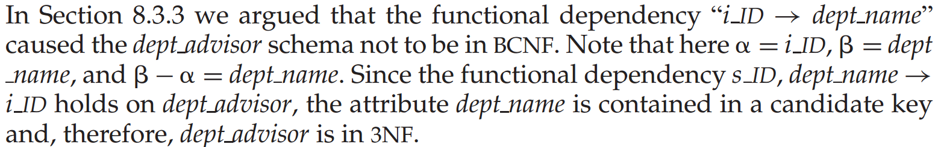
Third Normal Form - Example
A dependency α → β that satisfies only the third alternative of
the 3NF definition is not allowed in BCNF, but is allowed in 3NF.
Now, let us again consider the dept advisor relationship set, which has the following functional dependencies:

Slide 39
Third Normal Form - Example
A dependency α → β that satisfies only the third alternative of
the 3NF definition is not allowed in BCNF, but is allowed in 3NF.
Now, let us again consider the dept advisor relationship set, which has the following functional dependencies:
包含于候选码，所以满足第三范式

Slide 40
3NF
改造
  将S分解为
  STUDENT(S# , SN , SD)
  DEPT(SD,DEAN)
练习
  关系模式R（A，B，C，D），码为AB，给出它的一个函数依赖集，使得R属于2NF而不属于3NF

Slide 41
范式之间的关系
1NF
  关系模式S(S# , SN , SD , DEAN , C# , G)
消除非主属性对码的部分函数依赖
  （S#，C#） SN
  （S#，C#） SD
2NF
消除非主属性对码的传递函数依赖
  S_SD(S# , SN , SD , DEAN)
3NF
  S_SD ∉3NF，因为有S#→SD，SD→DEAN
消除主属性对码的部分函数依赖
BCNF
Dependencies
消除非平凡的多值依赖
BCNF
4NF

Slide 42
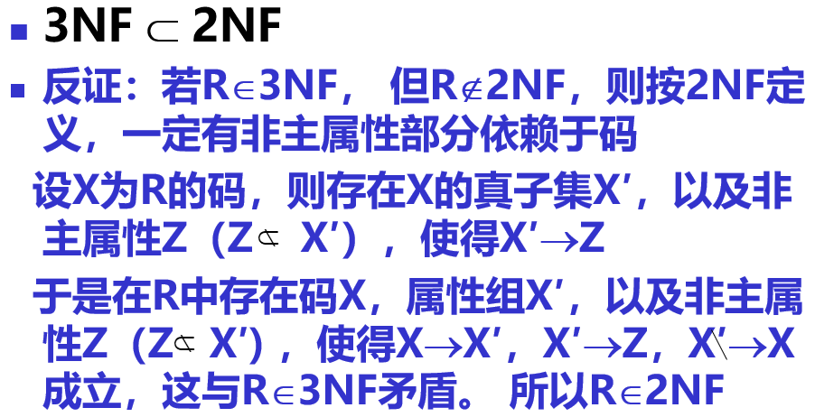
范式之间的关系
Notes:
结束

Slide 43
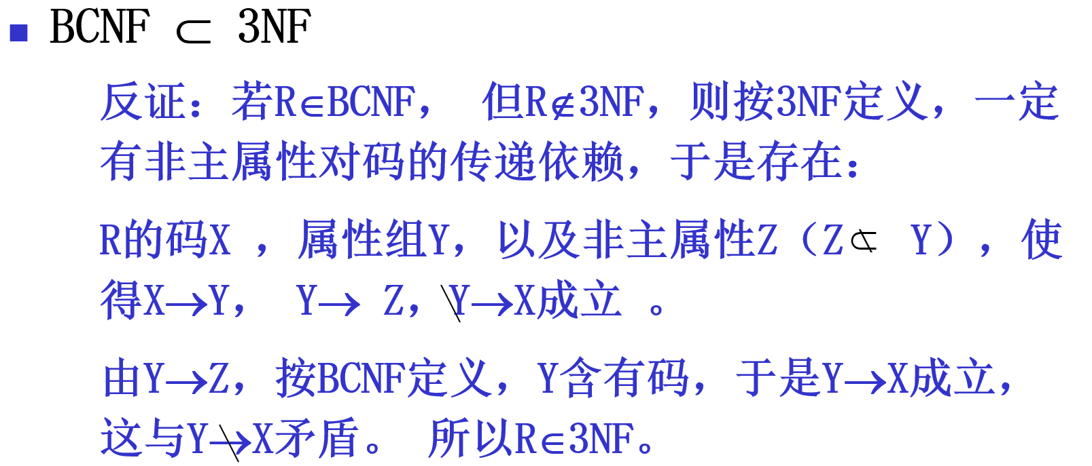
范式之间的关系

Slide 44
8.3.5 Higher Normal Forms
There are database schemas in BCNF that do not seem to be sufficiently normalized（BCNF约束依然不够）
Consider a relation
inst_info (ID, child_name, phone)
  where an instructor may have more than one phone and can have multiple children
ID
child_name
phone
99999
99999
99999
99999
David
David
William
Willian
512-555-1234
512-555-4321
512-555-1234
512-555-4321
inst_info
Notes:
BCNF?

Slide 45
How good is BCNF? (Cont.)
There are no non-trivial functional dependencies and therefore the relation is in BCNF.
Insertion anomalies – i.e., if we add a phone 981-992-3443 to 99999, we need to add two tuples（插入异常）
(99999, David, 981-992-3443)
(99999, William, 981-992-3443)

Slide 46
How good is BCNF? (Cont.)
Therefore, it is better to decompose inst_info into:
ID
child_name
inst_child
99999
99999
99999
99999
David
David
William
Willian
ID
phone
inst_phone
99999
99999
99999
99999
512-555-1234
512-555-4321
512-555-1234
512-555-4321
This suggests the need for higher normal forms, such as Fourth Normal Form (4NF), which we shall see later.

Slide 47
8.4 Functional Dependency Theory
It is useful to be able to reason systematically about functional dependencies as part of a process of testing schemas for BCNF
or 3NF. （对函数依赖进行系统地推理很有必要！）
8.4.1 Closure of a Set of Functional Dependencies （依赖集的闭包）
8.4.2 Closure of Attribute Sets （属性集的闭包）
8.4.3 Canonical Cover （正则覆盖）
8.4.4 Lossless Decomposition （无损分解）
8.4.5 Dependency Preservation （保持依赖）

Slide 48
8.4.1 Closure of a Set of Functional Dependencies(依赖集的闭包)
Given a set F set of functional dependencies, there are certain other functional dependencies that are logically implied（逻辑蕴含） by F.
（给定模式上的函数依赖集F，某些其他的函数依赖在该模式上也成立，称这些函数依赖被F逻辑蕴含）
  For e.g.: If A → B and B → C, then we can infer that A → C
The set of all functional dependencies logically implied by F is the closure of F.
We denote the closure of F by F⁺.

Slide 49
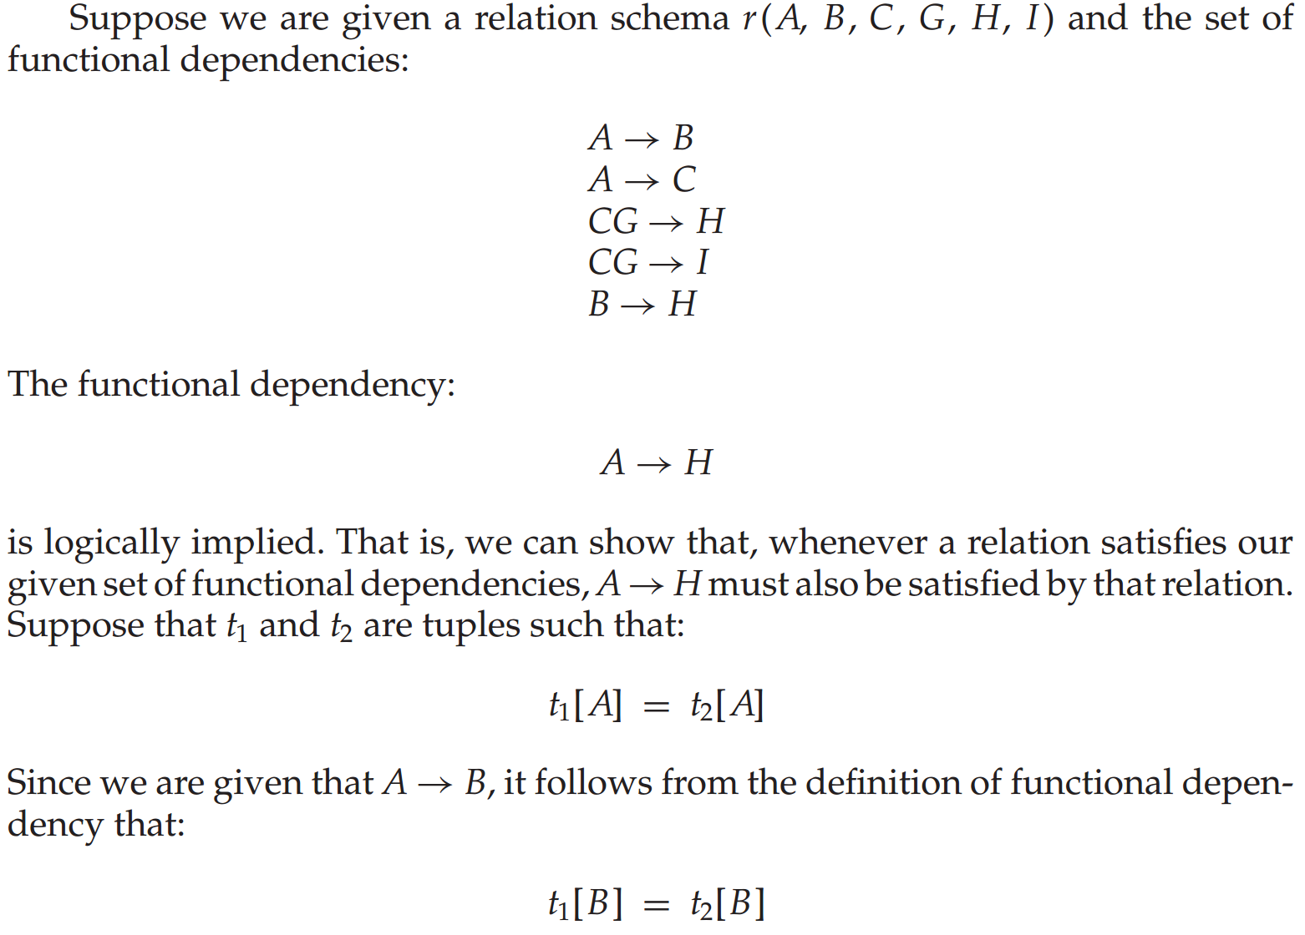
Example
关系模式
函数依赖集
被逻辑蕴含

Slide 50
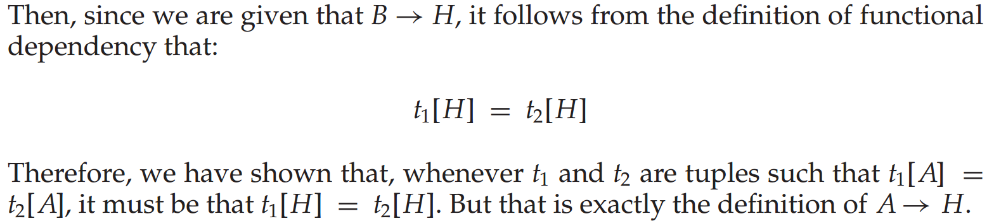
Example

Slide 51
Closure of a Set of Functional Dependencies
We can find F^{+,} the closure of F, by repeatedly applying
Armstrong’s Axioms:
  if β ⊆ α, then α → β (reflexivity 自反律)
  if α → β, then γ α → γ β (augmentation 增补律)
  if α → β, and β → γ, then α → γ (transitivity 传递律)
These rules are
  Sound（正确有效的） (generate only functional dependencies that actually hold), and
  Complete（完备的） (generate all functional dependencies that hold).

Slide 52

Armstrong公理系统(补充)
按函数依赖定义r是R<U, F>上的任一关系，t，s ∈ r
自反律：若Y ⊆ X， 则X → Y
t[X] = s[X]
Y⊆X
}
t[Y] = s[Y]
X → Y

Slide 53
Armstrong公理系统(补充)
增广律：若X → Y ，则XZ → YZ
t[XZ] = s[XZ]
t[X] = s[X]
}
t[Y] = s[Y]
X→Y
}
t[XZ] = s[XZ]
t[Z] = s[Z]
t[YZ] = s[YZ]
XZ→YZ

Slide 54
Armstrong公理系统(补充)
传递律：若X→Y，Y→Z，则X→Z
X → Y
t[X] = s[X]
}
t[Y] = s[Y]
}
t[Z] = s[Z]
Y → Z
X → Z

Slide 55
Example
R = (A, B, C, G, H, I)
F = { A → B
A → C
CG → H
CG → I
B → H }
some members of F⁺

Slide 56
Example
R = (A, B, C, G, H, I)
F = { A → B
A → C
CG → H
CG → I
B → H }
some members of F⁺
  A → H
    by transitivity from A → B and B → H（传递）
  AG → I
    by augmenting A → C with G, to get AG → CG
    and then transitivity with CG → I （增补、传递）

Slide 57
Procedure for Computing F⁺
To compute the closure of a set of functional dependencies F:
F ⁺ = F
repeat
for each functional dependency f in F⁺ （ F⁺ 中的函数依赖f）
apply reflexivity and augmentation rules on f
add the resulting functional dependencies to F ⁺
（在f上应用自反律和增补律，将结果加入到F ⁺中）
for each pair of functional dependencies f₁and f₂ in F ⁺
（F ⁺中的一对函数依赖f₁和f₂ ）
if f₁ and f₂ can be combined using transitivity
then add the resulting functional dependency to F ⁺
（ f₁和f₂ 可以使用传递律结合起来→将结果加入到F⁺中）
until F ⁺ does not change any further（ F⁺不再发生变化）
NOTE: We shall see an alternative procedure for this task later
₍However, doing so can be expensive, since F⁺ can be large.(2^{2n})₎

Slide 58
Example
R = (A, B, C, G, H, I)
F = { A → B
A → C
CG → H
CG → I
B → H }
some members of F⁺
  A → H
    by transitivity from A → B and B → H（传递）
  AG → I
    by augmenting A → C with G, to get AG → CG
    and then transitivity with CG → I （增补、传递）
  CG → HI
    by augmenting CG → I to infer CG → CGI,
    and augmenting of CG → H to infer CGI → HI,
    and then transitivity（增补、增补、传递）

Slide 59
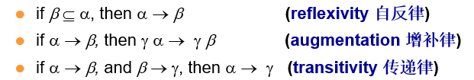
Closure of Functional Dependencies (Cont.)
Additional rules:
  If α → β holds and α → γ holds, then α → β γ holds
  (union合并律)
  If α → β γ holds, then α → β holds and α → γ holds (decomposition 分解律)
  If α → β holds and γ β → δ holds, then α γ → δ holds (pseudotransitivity 伪传递律)
  The above rules can be inferred from Armstrong’s axioms.

Slide 60
Armstrong公理系统
合并律：若X → Y，X → Z，则X → YZ
X → Y
增广律
}
X → XY
}
传递律
X → YZ
X → Z
增广律
}
XY → YZ

Slide 61
Armstrong公理系统
分解律:若X → YZ ，则X → Y，X → Z
Y ⊆ YZ
Z ⊆ YZ
自反律
}
YZ → Y
YZ → Z
}
X → Y
X → Z
传递律
X → YZ

Slide 62
Armstrong公理系统
伪传递律:若X → Y，WY → Z，则WX → Z
X → Y
增广律
}
WX → WY
}
传递律
WX → Z
WY → Z

Slide 63
8.4.2 Closure of Attribute Sets
We say that an attribute B is functionally determined（函数确定）by α if α → B.
To test whether a set α is a superkey, we must devise an algorithm for computing the set of attributes functionally determined by α. （判定α是否为超码→被α 函数确定的属性集）
One way of doing this is to compute F⁺ , take all functional dependencies with α as the left-hand side, and take the union of the right-hand sides of all such dependencies. （通过属性闭包的包含关系，检查依赖是否属于F⁺ ）
However, doing so can be expensive, since F⁺ can be large.(2^{2n})

Slide 64
Given a set of attributes α, define the closure of α under F (denoted by α⁺) as the set of attributes that are functionally determined by α under F.(属性集α，称函数依赖集F下被α函数确定的所有属性的集合成为F下α的闭包)
Algorithm to compute α⁺, the closure of α under F
result := α;
while (changes to result) do
for each β → γ in F do
begin
if β ⊆ result then result := result ∪ γ
end

Slide 65
Example of Attribute Set Closure
R = (A, B, C, G, H, I)
F = {A → B
A → C
CG → H
CG → I
B → H}
(AG)⁺
  1. result = AG
  2. result = ABCG (A → C and A → B)
  3. result = ABCGH (CG → H and CG ⊆ AGBC)
  4. result = ABCGHI (CG → I and CG ⊆ AGBCH)
Is AG a candidate key?
  Is AG a super key?
    Does AG → R? == Is (AG)⁺ ⊇ R
  Is any subset of AG a superkey?
    Does A → R? == Is (A)⁺ ⊇ R
    Does G → R? == Is (G)⁺ ⊇ R

Slide 66
Uses of Attribute Closure
There are several uses of the attribute closure algorithm:(用途)
Testing for superkey:（判断超码）
  To test if α is a superkey, we compute α^{+,} and check if α⁺ contains all attributes of R.
Testing functional dependencies（判断函数依赖：通过检测β ⊆ α⁺，可以检查函数依赖α → β 是否成立→简单、低代价、高可用）
  To check if a functional dependency α → β holds (or, in other words, is in F⁺), just check if β ⊆ α⁺.
  That is, we compute α⁺ by using attribute closure, and then check if it contains β.
  Is a simple and cheap test, and very useful
Computing closure of F（计算函数依赖闭包）
  For each γ ⊆ R, we find the closure γ⁺, and for each S ⊆ γ⁺, we output a functional dependency γ → S.

Slide 67
8.4.3 Canonical Cover（正则覆盖）
Sets of functional dependencies may have redundant dependencies that can be inferred from the others（函数依赖集中可能存在冗余的依赖）
  For example: A → C is redundant in: {A → B, B → C, A→ C}
  Parts of a functional dependency may be redundant
    E.g.: on RHS: {A → B, B → C, A → CD} can be simplified to
    {A → B, B → C, A → D}
    E.g.: on LHS: {A → B, B → C, AC → D} can be simplified to
    {A → B, B → C, A → D}
Intuitively, a canonical cover of F is a “minimal” set of functional dependencies equivalent to F, having no redundant dependencies or redundant parts of dependencies. （正则覆盖是最小的、不含无关属性、与F具有相同闭包的依赖集）

Slide 68
Extraneous Attributes（无关属性）
Consider a set F of functional dependencies and the functional dependency α → β in F.
  Attribute A is extraneous in α if A ∈ α
  and F logically implies (F – {α → β}) ∪ { (α – A) → β } .
  Attribute A is extraneous in β if A ∈ β
  and the set of functional dependencies
  (F – {α → β} ) ∪ { α →(β – A) } logically implies F.
Note: implication in the opposite direction is trivial in each of the cases above, since a “stronger” functional dependency always implies a weaker one（删除无关属性不影响表达力）
Example: Given F = {A → C, AB → C }
  B is extraneous in AB → C because {A → C, AB → C} logically implies A → C (I.e. the result of dropping B from AB → C).
Example: Given F = {A → C, AB → CD}
  C is extraneous in AB → CD since AB → C can be inferred even after deleting C

Slide 69
Testing if an Attribute is Extraneous
Consider a set F of functional dependencies and the functional dependency α → β in F.
To test if attribute A ∈ α is extraneous in α
  compute ({α} – A)⁺ using the dependencies in F
  check that ({α} – A)⁺ contains β; if it does, A is extraneous in α
  （计算去除属性A 的闭包，若右侧属性被包含，A即为无关属性）
To test if attribute A ∈ β is extraneous in β
  compute α⁺ using only the dependencies in
  F’ = (F – {α → β}) ∪ {α →(β – A)},
  check that α⁺ contains A; if it does, A is extraneous in β
  （在去除属性A依赖后的依赖集上，计算α的闭包，若属性A被包含，A即为无关属性）

Slide 70
Canonical Cover（正则覆盖）
A canonical cover for F is a set of dependencies F_{c} such that
  F logically implies（逻辑蕴含） all dependencies in F_{c,} and
  F_{c} logically implies all dependencies in F, and（相同的闭包）
  No functional dependency in F_{c} contains an extraneous attribute, and
  Each left side of functional dependency in F_{c} is unique.（没有无关属性且函数依赖左半部分是唯一的）
To compute a canonical cover for F:
repeat
Use the union rule to replace any dependencies in F（利用合并律）
α₁ → β₁ and α₁ → β₂ with α₁ → β₁ β₂
Find a functional dependency α → β with an （对每个函数依赖）
extraneous attribute either in α or in β （找无关属性）
/* Note: test for extraneous attributes done using F_{c,} not F*/
If an extraneous attribute is found, delete it from α → β（删无关属性）
until F does not change
Note: Union rule may become applicable after some extraneous attributes have been deleted, so it has to be re-applied

Slide 71
Computing a Canonical Cover
R = (A, B, C)
F = {A → BC
B → C
A → B
AB → C}
Combine A → BC and A → B into A → BC
  Set is now {A → BC, B → C, AB → C}
A is extraneous in AB → C
  Check if the result of deleting A from AB → C is implied by the other dependencies
    Yes: in fact, B → C is already present!
  Set is now {A → BC, B → C}
C is extraneous in A → BC
  Check if A → C is logically implied by A → B and the other dependencies
    Yes: using transitivity on A → B and B → C.
      Can use attribute closure of A in more complex cases
The canonical cover is: A → B
B → C
Notes:
删除后看依赖是否还能恢复。

Slide 72
8.4.4 Lossless-join Decomposition（无损分解）
For the case of R = (R₁, R₂), we require that for all possible relations r on schema R
r = ∏_{R1} (r ) ∏_{R2} (r )
（将r投影至R1 和R2上，将投影结果进行自然连接，得出r即为无损连接分解，否则为有损连接分解）
A decomposition of R into R₁ and R₂ is lossless join if at least one of the following dependencies is in F⁺:（ R₁ ∩ R₂ 是R₁或R₂ 的超码）
  R₁ ∩ R₂ → R₁
  R₁ ∩ R₂ → R₂

Slide 73
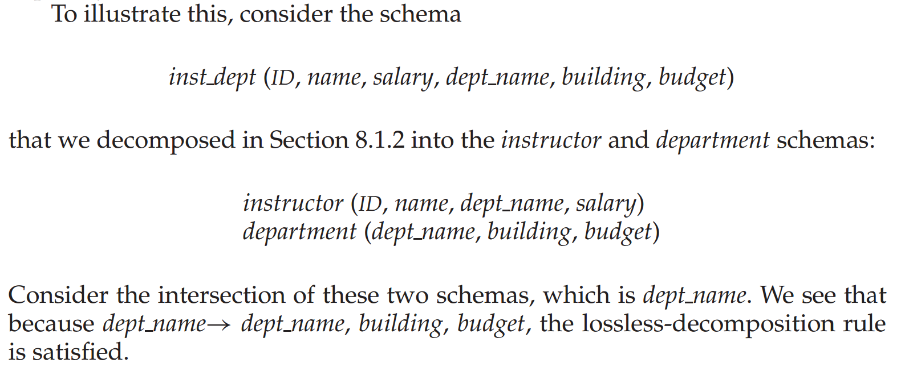
8.4.4 Lossless-join Decomposition（无损分解）
A decomposition of R into R₁ and R₂ is lossless join if at least one of the following dependencies is in F⁺:（ R₁ ∩ R₂ 是R₁或R₂ 的超码）
  R₁ ∩ R₂ → R₁
  R₁ ∩ R₂ → R₂

Slide 74

Example
R = (A, B, C)
F = {A → B, B → C)
  Can be decomposed in two different ways
R₁ = (A, B), R₂ = (B, C)
  Lossless-join decomposition:
  R₁ ∩ R₂ = {B} and B → BC
  Dependency preserving （保持依赖）
R₁ = (A, B), R₂ = (A, C)
  Lossless-join decomposition:
  R₁ ∩ R₂ = {A} and A → AB
  Not dependency preserving
  (cannot check B → C without computing R₁ R₂)

Slide 75
8.4.5 Dependency Preservation（保持依赖）
Let F_{i} be the set of dependencies F ⁺ that include only attributes in R_{i}.
    A decomposition is dependency preserving, if
    (F₁ ∪ F₂ ∪ … ∪ F_{n} )⁺ = F ⁺
    If it is not, then checking updates for violation of functional dependencies may require computing joins, which is expensive.

Slide 76
Testing for Dependency Preservation
To check if a dependency α → β is preserved in a decomposition of R into R₁, R₂, …, R_{n} ， we apply the following test (with attribute closure done with respect to F)（测试α → β 依赖是否依然保持）
  result = α
  while (changes to result) do
  for each R_{i} in the decomposition（依赖在各个分解中是否体现）
  t = (result ∩ R_{i})⁺ ∩ R_{i}
  result = result ∪ t
  If result contains all attributes in β, then the functional dependency α → β is preserved.
We apply the test on all dependencies in F to check if a decomposition is dependency preserving
This procedure takes polynomial time（多项式时间）, instead of the exponential time（指数时间） required to compute F⁺ and (F₁ ∪ F₂ ∪ … ∪ F_{n})⁺

Slide 77
Example
R = (A, B, C )
F = {A → B
B → C}
Key = {A}
R is not in BCNF
Decomposition R₁ = (A, B), R₂ = (B, C)
  R₁ and R₂ in BCNF
  Lossless-join decomposition
  Dependency preserving

Slide 78
8.5 Algorithms for Functional Dependencies
Real-world database schemas are much larger than the examples that fit in the pages of a book.
For this reason, we need algorithms for the generation of designs that are in appropriate normal form. In this section, we present algorithms for BCNF and 3NF. （需要能生成属于适当范式设计的算法）
8.5.1 BCNF Decomposition
  8.5.1.1 Testing for BCNF
  8.5.1.2 BCNF Decomposition Algorithm
8.5.2 3NF Decomposition
8.5.3 Correctness of the 3NF Algorithm
8.5.4 Comparison of BCNF and 3NF

Slide 79
模式分解算法
算法：分解关系模式为满足BCNF的一个无损分解
  输入：关系模式R（U，F）
  输出：R的一个为BCNF的无损连接分解ρ。

Slide 80
模式分解算法
算法：分解关系模式为满足BCNF的一个无损分解
  方法：
  1）令ρ={R}。
  2）检查ρ中每个关系模式是否均属于BCNF。若是，则算法终止。
  3）对ρ中每一个不满足BCNF的关系模式S，做如下操作
    S中必有不满足BCNF的非平凡的函数依赖X→A，其中X不是S的候选键。
    对S进行分解，分解为S₁（XA）和S₂（U_{S}-A），其中U_{S}为S的属性集，用S₁和S₂取代ρ中的S。返回步骤(2)。
  由于U中属性有限，因而有限次循环后算法一定终止。

Slide 81
模式分解算法
【例】有关系模式R<U,F>，U={C,T,H,I,S,G}，F={CS→G, C→T,TH →I,HI→C,HS→I}，将R分解成具有无损连接的BCNF。
解答：
1）令ρ={R}
2）检查ρ中每个关系模式是否均属于BCNF；
H、S是L类属性，且HS _{F}⁺ = U，所以HS为 R的一个候 选键。
由此可判断ρ中关系模式R不属于BCNF。

Slide 82
模式分解算法
【例】有关系模式R<U,F>，U={C,T,H,I,S,G}，F={CS→G, C→T,TH →I,HI→C,HS→I}，将R分解成具有无损连接的BCNF。
解答：
3）考虑CS→G，CS不是R的候选键，将R分解为
ρ={R₁（{CSG}，{CS→G}），
R₂（{CTHIS}，{ C→T,TH →I,HI→C,HS→I }）}；
R₁是BCNF，R₂不是(R₂的候选键仍为HS )，需对R₂进一步分解。

Slide 83
模式分解算法
【例】有关系模式R<U,F>，U={C,T,H,I,S,G}，F={CS→G, C→T,TH →I,HI→C,HS→I}，将R分解成具有无损连接的BCNF。
解答：
4）对于 R₂（{CTHIS}，{ C→T,TH →I,HI→C,HS→I }）
考虑C→T，C不是R₂的候选键，将R₂分解为
ρ={R₂₁（{CT}，{C→T}），
R₂₂（{CHIS}，{CH →I,HI→C,HS→I }）}；
(∵C→T，TH →I ∴CH →I )
R₂₁是BCNF，R₂₂不是(R₂₂的候选键仍为HS )，需对R₂₂进一步分解。

Slide 84
模式分解算法
【例】有关系模式R<U,F>，U={C,T,H,I,S,G}，F={CS→G, C→T,TH →I,HI→C,HS→I}，将R分解成具有无损连接的BCNF。
解答：
对于R₂₂（{CHIS}，{CH →I,HI→C,HS→I }）
考虑CH →I，CH不是R₂₂的候选键，将 分解为
ρ={R₂₂₁（{CHI }，{ CH →I，HI→C }），
R₂₂₂（{CHS}，{HS→C }）}；
R₂₂₁ 和R₂₂₂均是BCNF，不需进一步分解。

Slide 85
模式分解算法
【例】有关系模式R<U,F>，U={C,T,H,I,S,G}，F={CS→G, C→T,TH →I,HI→C,HS→I}，将R分解成具有无损连接的BCNF。
解答：
因此，将R分解为ρ={R₁（{CSG }，{CS→G }），R₂₁（{CT}，{C→T }），R₂₂₁（{CHI }，{ CH →I，HI→C }），R₂₂₂（{CHS}，{HS→C }）}，即为所求。
在关系模式R₂₂₂（{CHS}，{HS→C}）中， 包含R的一个候选键HS ，利用算法5.3可验证分解ρ具有无损连接性。

Slide 86
模式分解算法
分解关系模式为满足3NF的一个无损且保持函数依赖的分解算法
  输入：关系模式R（U，F）
  输出：R的一个具有无损连接性且保持函数依赖的满足3NF的分解ρ

Slide 87
模式分解算法
分解关系模式为满足3NF的一个无损且保持函数依赖的分解算法
  1）求F的最小覆盖F_{m}，令F= F_{m}。
  2）若有X→A∈F，且XA=U，输出ρ={R}，算法结束。
  3）对F按具有相同左部的原则分组，即F中所有形如X→A₁,X→A₂,…，X→A_{n}的函数依赖为一组。每一分组中包含的函数依赖子集F_{i}’所涉及的全部属性组成一个属性集Ui。若Ui⊆Uj（i≠j）就去掉Ui。
  4）将R中不在F中出现的属性，单独构成一属性集Ui。

Slide 88
模式分解算法
分解关系模式为满足3NF的一个无损且保持函数依赖的分解算法
  5）将Ui及F在Ui上的投影F_{i}构成一个关系模式Ri(Ui,Fi)，由于F是最小函数依赖集，Ri(Ui,Fi)一定是属于以X为候选键的3NF。并且Fi’一定被Fi所包含，因此各关系模式Ri(Ui,Fi) 组成的分解ρ是保持函数依赖的。
  6）若某个Ui中已包含R中的候选键，则该分解也就具有无损连接性。若Ui中均不包含R中的候选键，则在分解ρ的结果上再并入一个关系模式R_{k}(K,F_{K})，其中K为R的某一候选键，F_{K}为F在K上的投影。

Slide 89
模式分解算法
【例】关系模式R（U，F），其中U={ E，G，H，I，J }，F={ E→I，J→I，I→G，GH→I，IH→E }，将R分解为3NF，并使之具有无损连接性和保持函数依赖特性。
解答：
（1）F已为最小函数依赖集。
（2）没有类似X→A∈F，且XA=U的函数依赖。
（3）对F按具有相同左部的原则分组，得到每组所对应的属性集U1= EI、U2= IJ、U3= GI、U4= GHI、U5= EHI。因为U1⊆ U5、U3⊆ U4，所以去掉U1、U3。
（4）R中的所有属性均在F中出现。

Slide 90
模式分解算法
【例(续)】关系模式R（U，F），其中U={ E，G，H，I，J }，F={ E→I，J→I，I→G，GH→I，IH→E }，将R分解为3NF，并使之具有无损连接性和保持函数依赖特性。
解答：
（5）将Ui及F在Ui上的投影Fi构成一个关系模式Ri（Ui,Fi），则分解ρ={R1（{ I,J }, { J→I }），R2（{G,H,I}，{I→G,GH→I}），R3（{E,H,I}，{ E→I,IH→E }）}保持函数依赖，且分解后的每个关系模式均为3NF。
（6）可确定R的一个候选键HJ，由于Ui 均不包含HJ，则ρ=ρ∪{R4（{H,J}）}，因此将R分解为ρ={ R1（{ I,J }, { J→I }），
R2（{G,H,I}，{I→G,GH→I}），R3（{E,H,I}，{ E→I,IH→E }），
R4（{H,J}）}。
分解具有无损连接性，ρ即为所求。

Slide 91
模式分解算法
这三个目标有时不能同时满足，一般只能做到如下几点：
  若分解保持函数依赖，那么模式总可以分解到3NF，但不一定能达到BCNF；
  若分解具有无损连接性，那么模式一定能分解到BCNF；
  若分解既保持函数依赖，又具有无损连接性，那么模式可以分解到3NF，但不一定能达到BCNF。

Slide 92
多值依赖
关系模式TEACH（C#，T#，B#），一门课程由多个教师讲授，一门课程使用相同的一套参考书。它的码是（C#，T#，B#），所以属于BCNF
C# | T# | B#
C1 | T1 | B1
C1 | T1 | B2
C1 | T2 | B1
C1 | T2 | B2
C2 | T1 | B3
C2 | T1 | B4
C2 | T3 | B3
C2 | T3 | B4
C# | T# | B#
C1 | {T1,T2} | {B1,B2}
C2 | {T1,T3} | {B3,B4}
描述两个独立的一对多联系

Slide 93
多值依赖
不良特性
  插入异常：当某门课程增加一名教员时，该门课程有多少本参考书就必须插入多少个元组；同样当某门课程需要增加一本参考书时，它有多少个教员就必须插入多少个元组
  删除异常：当删除一门课程的某个教员或者某本参考书时，需要删除多个元组
  更新异常：当一门课程的教员或参考书作出改变时，需要修改多个元组
  数据冗余：同一门课的教员与参考书的信息被反复存储多次

Slide 94
多值依赖
定义
  描述型：关系模式R(U)，X、Y、Z ⊂ U，并且Z = U – X – Y，多值依赖X →→ Y成立当且仅当对R(U)的任一关系r，给定的一对（X，Z）值有一组Y的值，这组值仅仅决定于X值而与z值无关。
  如在关系模式TEACH中，对(C1 , B1)有一组T#值(T1 , T2)，对(C1 , B2)也有一组T#值(T1 , T2)，这组值仅取决于C#的取值，而与B#的取值无关。因此，T#多值依赖于C#，记作C#→→T#，同样有C#→→B#

Slide 95
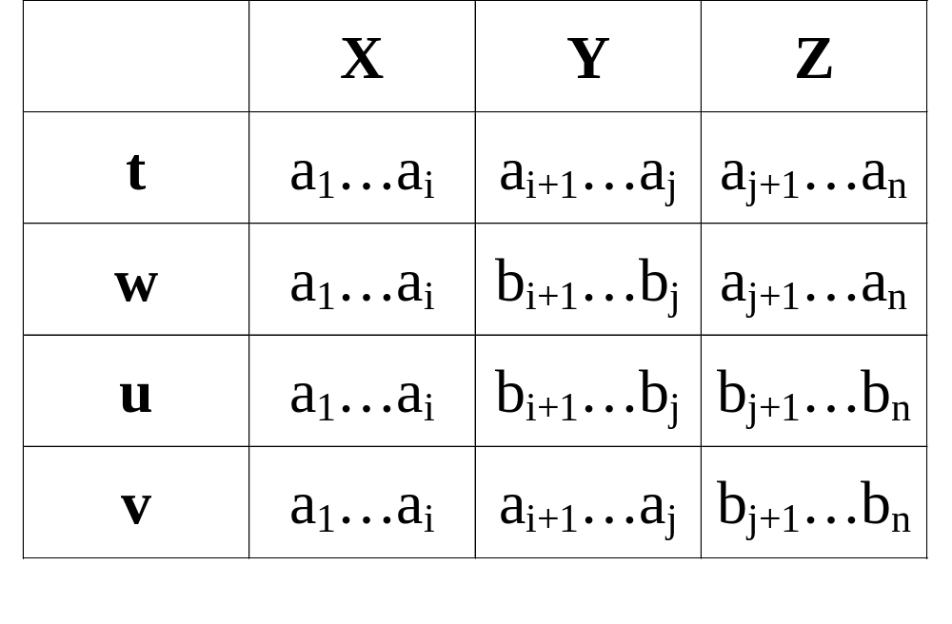
多值依赖

Slide 96
多值依赖
形式化定义：关系模式R(U)，X、Y、Z⊂U，Z=U–X– Y，对于R(U)的任一关系r，若存在元组t1，t2，使得t1[X] = t2[X]，那么就必然存在元组t3，t4，使得：
  t3[X] = t1[X] = t4[X] = t2[X]
  t3[Y] = t1[Y]， t4[Y] = t2[Y]
  t3[Z] = t2[Z]， t4[Z] = t1[Z]
  则称Y多值依赖于X，记作X →→ Y
  若(C#, T#, B#)满足C#→→T#，含有元组t1=(C1, T1, B1)，t2=(C1, T2, B2)， 则也一定含有元组t3=(C1, T2, B1)，t4=(C1, T1, B2)。

Slide 97
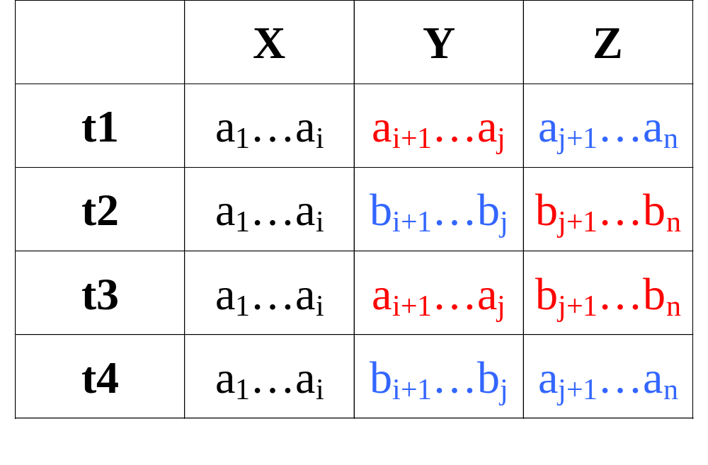
多值依赖

Slide 98
多值依赖
找出关系上所满足的多值依赖
A | B | C
a1 | b1 | c1
a1 | b1 | c2
a2 | b1 | c1
a2 | b1 | c3
C→→B？若使B→→C成立，需加入哪些元组？
B | C | A
b1 | c2 | a1
b1 | c1 | a2
B | C | A
t1.B | t1.C | t2.A
t2.B | t2.C | t1.A
B | C | A
b1 | c1 | a1
b1 | c2 | a2
t1
t2
t3
t4
t3
t4

Slide 99
多值依赖
性质
  多值依赖具有对称性，即
  若X→→Y，则X→→Z，其中Z=U–X–Y
  函数依赖是多值依赖的特例，即
  若X→Y，则X→→Y
  若X→→Y，U–X–Y=ϕ，则称X→→Y为平凡的多值依赖

Slide 100
多值依赖 vs 函数依赖
区别
  函数依赖规定某些元组不能出现在关系中，也称为相等产生依赖(equality-generation dependency)
  多值依赖要求某种形式的其它元组必须在关系中，称为元组产生依赖(tuple-generating dependency)
有效性范围
  X→Y的有效性仅决定于X、Y属性集上的值，它在任何属性集W（XY ⊆ W ⊆ U）上都成立
  若X→Y在R(U)上成立，则对于任何Y′⊆ Y，均有X→Y′成立

Slide 101
多值依赖 vs 函数依赖
  X→→Y的有效性与属性集范围有关
  X→→Y在属性集W（XY ⊆ W ⊆ U）上成立，但在U上不一定成立
  X→→Y在U上成立 ⇒ X→→Y在属性集W（XY ⊆ W ⊆ U）上成立
  若在R(U)上，X→→Y在属性集W(XY ⊆ W ⊆ U)上成立，则称X→→Y为R(U)的嵌入式多值依赖
  若X→→Y在R(U)上成立，则不能断言对于Y′⊆ Y，是否有X→→Y′成立

Slide 102
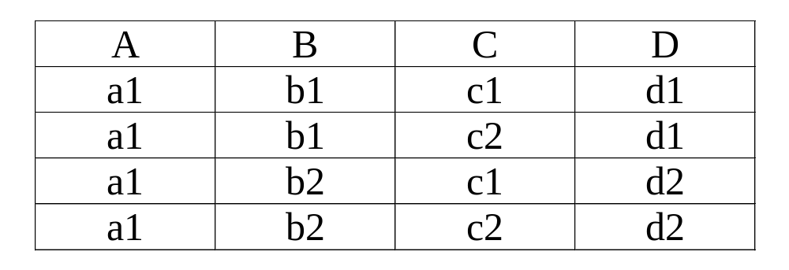
多值依赖 vs 函数依赖
A→→B在{ABC} {ABCD}
A
B
C
D
A→→BC
A→→B
a1
b1
c1
d1
a1
b1
c1
d2
a1
b2
c2
d1
a1
b2
c2
d2

Slide 103
多值依赖 vs 函数依赖
A
B
C
D
A→→B在{ABC}上成立，而在{ABCD}上不成立
a1
b1
c1
d1
a1
b1
c2
d1
a1
b2
c1
d2
a1
b2
c2
d2
A
B
C
D
A→→BC
成立A→→B不成立
a1
b1
c1
d1
a1
b1
c1
d2
a1
b2
c2
d1
a1
b2
c2
d2

Slide 104
4NF
定义
  关系模式R< U , F > ∈ 1NF，若X→→Y（Y⊄X）是非平凡的多值依赖，X必含有码，则称R∈4NF
  如关系模式CTB，C#→→T#，C#→→B#，码为(C#, T#, B#)，所以CTB∉4NF
  如果一门课Ci有m个教员，n本参考书，则关系中分量为Ci的元组共有m×n个，数据冗余非常大
改造
  将CTB分解为CT（C#，T#），CB（C#，B#），在分解后的关系中分量为Ci的元组共有m + n个
Notes:
在全键表中，键的一部分可以确定至多一个其他字段的多个值。4NF仅用于全键表。
第四范式的定义很简单：已经是BC范式，并且不包含多值依赖关系。

Slide 105
4NF
如果R ∈ 4NF
  不允许有非平凡且非函数依赖的多值依赖
  允许的非平凡多值依赖是函数依赖

Slide 106
思考
任何一个二目关系模式R（A，B）一定属于BCNF吗？一定属于4NF吗？
一个全是主属性的关系模式一定可以达到第几范式？
一个全码的关系模式一定可以达到第几范式？

Slide 107
Testing for BCNF
To check if a non-trivial dependency α →β causes a violation of BCNF
  1. compute α⁺ (the attribute closure of α), and （每个非平凡依赖由超码决定）
  2. verify that it includes all attributes of R, that is, it is a superkey of R.
Simplified test: To check if a relation schema R is in BCNF, it suffices to check only the dependencies in the given set F for violation of BCNF, rather than checking all dependencies in F⁺.（只需检查给定集合F中的函数依赖是否违法BCNF就足够了）
  If none of the dependencies in F causes a violation of BCNF, then none of the dependencies in F⁺ will cause a violation of BCNF either.
However, simplified test using only F is incorrect when testing a relation in a decomposition of R（分解之后上一步检测即不再适用）
  Consider R = (A, B, C, D, E), with F = { A → B, BC → D}
    Decompose R into R₁ = (A,B) and R₂ = (A,C,D, E)
    Neither of the dependencies in F contain only attributes from
    (A,C,D,E) so we might be mislead into thinking R₂ satisfies BCNF. （F中没有依赖包含R₂的属性）
    In fact, dependency AC → D in F⁺ shows R₂ is not in BCNF.

Slide 108
Testing Decomposition for BCNF
To check if a relation R_{i} in a decomposition of R is in BCNF,
  Either test R_{i} for BCNF with respect to the restriction of F to R_{i} (that is, all FDs in F⁺ that contain only attributes from R_{i})
  or use the original set of dependencies F that hold on R, but with the following test:
      for every set of attributes α ⊆ R_{i}, check that α⁺ (the attribute closure of α) either includes no attribute of R_{i}- α, or includes all attributes of R_{i}.（对于R_{i}中属性的每个子集α ，确保α⁺ （F下α的属性闭包）要么不包含R_{i}- α的任何属性，要么包含R_{i}的所有属性）
    If the condition is violated by some α → β in F, the dependency
    α → (α⁺ - α ) ∩ R_{i}
    can be shown to hold on R_{i}, and R_{i} violates BCNF.（ R_{i} 违反BCNF ）
    We use above dependency to decompose R_{i}

Slide 109
BCNF Decomposition Algorithm
result := {R };
done := false;
compute F ⁺;
while (not done) do
if (there is a schema R_{i} in result that is not in BCNF)（ result 中存在模式R_{i}不属于BCNF）
then begin
let α  → β be a nontrivial functional dependency(非平凡函数依赖) that
holds on R_{i} such that α  → R_{i} is not in F ⁺,
and α ∩ β = ∅;
result := (result – R_{i} ) ∪ (R_{i} – β) ∪ (α, β );
end
else done := true;
Note: each R_{i} is in BCNF, and decomposition is lossless-join.（算法结果不仅是一个BCNF分解，而且是一个无损分解）

Slide 110
BCNF and Dependency Preservation
It is not always possible to get a BCNF decomposition that is
dependency preserving（无法同时保持函数依赖）
R = (J, K, L )
F = {JK → L
L → K }
Two candidate keys = JK and JL
R is not in BCNF
Any decomposition of R will fail to preserve
JK → L ( 损失了该依赖关系 )
This implies that testing for JK → L requires a join

Slide 111
Example of BCNF Decomposition
R = (A, B, C )
F = {A → B
B → C}
Key = {A}
R is not in BCNF (B → C but B is not superkey)
Decomposition
  R₁ = (B, C)
  R₂ = (A,B)

Slide 112
Example of BCNF Decomposition
class (course_id, title, dept_name, credits, sec_id, semester, year, building, room_number, capacity, time_slot_id)
Functional dependencies:
  course_id→ title, dept_name, credits
  building, room_number→capacity
  course_id, sec_id, semester, year→building, room_number, time_slot_id
A candidate key {course_id, sec_id, semester, year}.
BCNF Decomposition:
  course_id→ title, dept_name, credits holds
    but course_id is not a superkey.
  We replace class by:
    course(course_id, title, dept_name, credits)
    class-1 (course_id, sec_id, semester, year, building,
    room_number, capacity, time_slot_id)

Slide 113
BCNF Decomposition (Cont.)
course is in BCNF
  How do we know this?
building, room_number→capacity holds on class-1
  but {building, room_number} is not a superkey for class-1.
  We replace class-1 by:
    classroom (building, room_number, capacity)
    section (course_id, sec_id, semester, year, building, room_number, time_slot_id)
classroom and section are in BCNF.

Slide 114
8.5.2 Third Normal Form: Motivation
There are some situations where
  BCNF is not dependency preserving, and
  efficient checking for FD violation on updates is important
Solution: define a weaker normal form, called Third Normal Form (3NF)
  Allows some redundancy (with resultant problems; we will see examples later)
  But functional dependencies can be checked on individual relations without computing a join.
  There is always a lossless-join, dependency-preserving decomposition into 3NF.

Slide 115
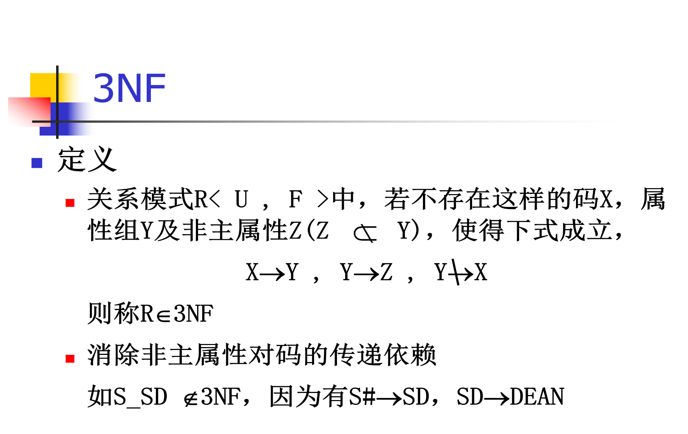
3NF
    U 组成该关系的属性名集合
F 属性间的数据依赖集合
系名
系主任名

Slide 116
3NF
A relation schema R is in third normal form (3NF) if for all:
α → β in F⁺
at least one of the following holds:
  α → β is trivial (i.e., β ∈ α)
  α is a superkey for R
  Each attribute A in β – α is contained in a candidate key for R.(没说单个候选码必须包含β – α 中的所有属性， β – α 中的每个属性A可能包含于不同的候选码中)

Slide 117
3NF Example
Relation dept_advisor:
  dept_advisor (s_ID, i_ID, dept_name)
  F = {s_ID, dept_name → i_ID, i_ID → dept_name}
  Two candidate keys: s_ID, dept_name, and i_ID, s_ID（两个候选键）
  R is in 3NF
    s_ID, dept_name → i_ID s_ID
      dept_name is a superkey
    i_ID → dept_name
      dept_name is contained in a candidate key

Slide 118
Redundancy in 3NF
There is some redundancy in this schema（冗余）
Example of problems due to redundancy in 3NF
  R = (J, K, L)
  F = {JK → L, L → K }
J
L
K
j₁
j₂
j₃
null
l₁
l₁
l₁
l₂
k₁
k₁
k₁
k₂
  dept_advisor (s_ID, i_ID, dept_name)
  F = {s_ID, dept_name → i_ID, i_ID → dept_name}
repetition of information (e.g., the relationship l₁, k₁)
  (i_ID, dept_name)
need to use null values (e.g., to represent the relationship
l₂, k₂ where there is no corresponding value for J).
  (i_ID, dept_nameI) if there is no separate relation mapping instructors to departments

Slide 119
Testing for 3NF
Optimization: Need to check only FDs in F, need not check all FDs in F⁺.
Use attribute closure to check for each dependency α → β, if α is a superkey.
If α is not a superkey, we have to verify if each attribute in β is contained in a candidate key of R
  this test is rather more expensive, since it involve finding candidate keys
  testing for 3NF has been shown to be NP-hard
  Interestingly, decomposition into third normal form (described shortly) can be done in polynomial time

Slide 120
3NF Decomposition Algorithm
Let F_{c} be a canonical cover for F;
i := 0;
for each functional dependency α → β in F_{c} do
if none of the schemas R_{j}, 1 ≤ j ≤ i contains α β
then begin
i := i + 1;
R_{i} := α β
end
if none of the schemas R_{j}, 1 ≤ j ≤ i contains a candidate key for R
then begin
i := i + 1;
R_{i} := any candidate key for R;
end
/* Optionally, remove redundant relations */
repeat
if any schema R_{j} is contained in another schema R_{k}
then /* delete R_{j} */
R_{j} = R;;
i=i-1;
return (R₁, R₂, ..., R_{i})

Slide 121
3NF Decomposition Algorithm (Cont.)
Above algorithm ensures:
  each relation schema R_{i} is in 3NF
  decomposition is dependency preserving and lossless-join
  Proof of correctness is at end of this presentation (click here)

Slide 122
3NF Decomposition: An Example
Relation schema:
  cust_banker_branch = (customer_id, employee_id, branch_name, type )
The functional dependencies for this relation schema are:
  customer_id, employee_id → branch_name, type
  employee_id → branch_name
  customer_id, branch_name → employee_id
We first compute a canonical cover
  branch_name is extraneous in the r.h.s. of the 1st dependency
  No other attribute is extraneous, so we get F_{C} =
  customer_id, employee_id → type
  employee_id → branch_name
  customer_id, branch_name → employee_id

Slide 123
3NF Decompsition Example (Cont.)
The for loop generates following 3NF schema:
(customer_id, employee_id, type )
(employee_id, branch_name)
(customer_id, branch_name, employee_id)
  Observe that (customer_id, employee_id, type ) contains a candidate key of the original schema, so no further relation schema needs be added
At end of for loop, detect and delete schemas, such as (employee_id, branch_name), which are subsets of other schemas
  result will not depend on the order in which FDs are considered
The resultant simplified 3NF schema is:
(customer_id, employee_id, type)
(customer_id, branch_name, employee_id)

Slide 124
模式分解算法
关于模式分解的几个重要事实：
低一级范式
分解
高一级范式
保持函数依赖
保持函数依赖
无损连接
无损连接
3NF不一定BCNF
BCNF

Slide 125
8.5.4 Comparison of BCNF and 3NF
It is always possible to decompose a relation into a set of relations that are in 3NF such that:
  the decomposition is lossless
  the dependencies are preserved
It is always possible to decompose a relation into a set of relations that are in BCNF such that:
  the decomposition is lossless
  it may not be possible to preserve dependencies.

Slide 126
Design Goals
Goal for a relational database design is:
  BCNF.
  Lossless join.
  Dependency preservation.
If we cannot achieve this, we accept one of
  Lack of dependency preservation
  Redundancy due to use of 3NF
Interestingly, SQL does not provide a direct way of specifying functional dependencies other than superkeys.
Can specify FDs using assertions, but they are expensive to test, (and currently not supported by any of the widely used databases!)
Even if we had a dependency preserving decomposition, using SQL we would not be able to efficiently test a functional dependency whose left hand side is not a key.

Slide 127
8.6 Decomposition Using Multivalued Dependencies
8.6.1 Multivalued Dependencies
8.6.2 Fourth Normal Form
8.6.3 4NF Decomposition

Slide 128
8.6.1 Multivalued Dependencies
Suppose we record names of children, and phone numbers for instructors:
  inst_child(ID, child_name)
  inst_phone(ID, phone_number)
If we were to combine these schemas to get
  inst_info(ID, child_name, phone_number)
  Example data:
  (99999, David, 512-555-1234)
  (99999, David, 512-555-4321)
  (99999, William, 512-555-1234)
  (99999, William, 512-555-4321)
This relation is in BCNF
  Why?

Slide 129
Multivalued Dependencies (MVDs)
Let R be a relation schema and let α ⊆ R and β ⊆ R. The multivalued dependency(多值依赖)
α →→ β
holds on R if in any legal relation r(R), for all pairs for tuples t₁ and t₂ in r such that t₁[α] = t₂ [α], there exist tuples t₃ and t₄ in r such that:
t₁[α] = t₂ [α] = t₃ [α] = t₄ [α]
t₃[β] = t₁ [β]
t₃[R – β] = t₂[R – β]
t₄ [β] = t₂[β]
t₄[R – β] = t₁[R – β]

Slide 130

MVD (Cont.)
Tabular representation of α →→ β

Slide 131
Example
Let R be a relation schema with a set of attributes that are partitioned into 3 nonempty subsets.
Y, Z, W
We say that Y →→ Z (Y multidetermines Z )
if and only if for all possible relations r (R )
< y₁, z₁, w₁ > ∈ r and < y₁, z₂, w₂ > ∈ r
then
< y₁, z₁, w₂ > ∈ r and < y₁, z₂, w₁ > ∈ r
Note that since the behavior of Z and W are identical it follows that
Y →→ Z if Y →→ W

Slide 132
Example (Cont.)
In our example:
ID →→ child_name
ID →→ phone_number
The above formal definition is supposed to formalize the notion that given a particular value of Y (ID) it has associated with it a set of values of Z (child_name) and a set of values of W (phone_number), and these two sets are in some sense independent of each other.
Note:
  If Y → Z then Y →→ Z
  Indeed we have (in above notation) Z₁ = Z₂
  The claim follows.

Slide 133
Use of Multivalued Dependencies
We use multivalued dependencies in two ways:
  1. To test relations to determine whether they are legal under a given set of functional and multivalued dependencies
  2. To specify constraints on the set of legal relations. We shall thus concern ourselves only with relations that satisfy a given set of functional and multivalued dependencies.
If a relation r fails to satisfy a given multivalued dependency, we can construct a relations r′ that does satisfy the multivalued dependency by adding tuples to r.

Slide 134
Theory of MVDs
From the definition of multivalued dependency, we can derive the following rule:
  If α → β, then α →→ β
That is, every functional dependency is also a multivalued dependency
The closure D⁺ of D is the set of all functional and multivalued dependencies logically implied by D.
  We can compute D⁺ from D, using the formal definitions of functional dependencies and multivalued dependencies.
  We can manage with such reasoning for very simple multivalued dependencies, which seem to be most common in practice
  For complex dependencies, it is better to reason about sets of dependencies using a system of inference rules (see Appendix C).

Slide 135
8.6.2 Fourth Normal Form
A relation schema R is in 4NF with respect to a set D of functional and multivalued dependencies if for all multivalued dependencies in D⁺ of the form α →→ β, where α ⊆ R and β ⊆ R, at least one of the following hold:
  α →→ β is trivial (i.e., β ⊆ α or α ∪ β = R)
  α is a superkey for schema R
If a relation is in 4NF it is in BCNF

Slide 136
Restriction of Multivalued Dependencies
The restriction of D to R_{i} is the set D_{i} consisting of
  All functional dependencies in D⁺ that include only attributes of R_{i}
  All multivalued dependencies of the form
    α →→ (β ∩ R_{i})
  where α ⊆ R_{i} and α →→ β is in D⁺

Slide 137
8.6.3 4NF Decomposition Algorithm
result: = {R};
done := false;
compute D⁺;
Let D_{i} denote the restriction of D⁺ to R_{i}
while (not done)
if (there is a schema R_{i} in result that is not in 4NF) then
begin
let α →→ β be a nontrivial multivalued dependency that holds
on R_{i} such that α → R_{i} is not in D_{i}, and α∩β=φ;
result := (result - R_{i}) ∪ (R_{i} - β) ∪ (α, β);
end
else done:= true;
Note: each R_{i} is in 4NF, and decomposition is lossless-join

Slide 138
Example
R =(A, B, C, G, H, I)
F ={ A →→ B
B →→ HI
CG →→ H }
R is not in 4NF since A →→ B and A is not a superkey for R
Decomposition
a) R₁ = (A, B) (R₁ is in 4NF)
b) R₂ = (A, C, G, H, I) (R₂ is not in 4NF, decompose into R₃ and R₄)
c) R₃ = (C, G, H) (R₃ is in 4NF)
d) R₄ = (A, C, G, I) (R₄ is not in 4NF, decompose into R₅ and R₆)
  A →→ B and B →→ HI ➔ A →→ HI, (MVD transitivity), and
  and hence A →→ I (MVD restriction to R₄)
e) R₅ = (A, I) (R₅ is in 4NF)
f)R₆ = (A, C, G) (R₆ is in 4NF)

Slide 139
Further Normal Forms
Join dependencies generalize multivalued dependencies
  lead to project-join normal form (PJNF) (also called fifth normal form)
A class of even more general constraints, leads to a normal form called domain-key normal form.
Problem with these generalized constraints: are hard to reason with, and no set of sound and complete set of inference rules exists.
Hence rarely used

Slide 140
Overall Database Design Process
We have assumed schema R is given
  R could have been generated when converting E-R diagram to a set of tables.
  R could have been a single relation containing all attributes that are of interest (called universal relation).
  Normalization breaks R into smaller relations.
  R could have been the result of some ad hoc design of relations, which we then test/convert to normal form.

Slide 141
ER Model and Normalization
When an E-R diagram is carefully designed, identifying all entities correctly, the tables generated from the E-R diagram should not need further normalization.
However, in a real (imperfect) design, there can be functional dependencies from non-key attributes of an entity to other attributes of the entity
  Example: an employee entity with attributes
  department_name and building,
  and a functional dependency
  department_name→ building
  Good design would have made department an entity
Functional dependencies from non-key attributes of a relationship set possible, but rare --- most relationships are binary

Slide 142
Denormalization for Performance
May want to use non-normalized schema for performance
For example, displaying prereqs along with course_id, and title requires join of course with prereq
Alternative 1: Use denormalized relation containing attributes of course as well as prereq with all above attributes
  faster lookup
  extra space and extra execution time for updates
  extra coding work for programmer and possibility of error in extra code
Alternative 2: use a materialized view defined as
course prereq
  Benefits and drawbacks same as above, except no extra coding work for programmer and avoids possible errors

Slide 143
Other Design Issues
Some aspects of database design are not caught by normalization
Examples of bad database design, to be avoided:
Instead of earnings (company_id, year, amount ), use
  earnings_2004, earnings_2005, earnings_2006, etc., all on the schema (company_id, earnings).
    Above are in BCNF, but make querying across years difficult and needs new table each year
  company_year (company_id, earnings_2004, earnings_2005,
  earnings_2006)
    Also in BCNF, but also makes querying across years difficult and requires new attribute each year.
    Is an example of a crosstab, where values for one attribute become column names
    Used in spreadsheets, and in data analysis tools

Slide 144
Modeling Temporal Data
Temporal data have an association time interval during which the data are valid.
A snapshot is the value of the data at a particular point in time
Several proposals to extend ER model by adding valid time to
  attributes, e.g., address of an instructor at different points in time
  entities, e.g., time duration when a student entity exists
  relationships, e.g., time during which an instructor was associated with a student as an advisor.
But no accepted standard
Adding a temporal component results in functional dependencies like
ID → street, city
not to hold, because the address varies over time
A temporal functional dependency X → Y holds on schema R if the functional dependency X → Y holds on all snapshots for all legal instances r (R).
⧫

Slide 145
Modeling Temporal Data (Cont.)
In practice, database designers may add start and end time attributes to relations
  E.g., course(course_id, course_title) is replaced by
    course(course_id, course_title, start, end)
    Constraint: no two tuples can have overlapping valid times
      Hard to enforce efficiently
Foreign key references may be to current version of data, or to data at a point in time
  E.g., student transcript should refer to course information at the time the course was taken

Slide 146
End of Chapter

Slide 147
Proof of Correctness of 3NF Decomposition Algorithm

Slide 148
Correctness of 3NF Decomposition Algorithm
3NF decomposition algorithm is dependency preserving (since there is a relation for every FD in F_{c})
Decomposition is lossless
  A candidate key (C ) is in one of the relations R_{i} in decomposition
  Closure of candidate key under F_{c} must contain all attributes in R.
  Follow the steps of attribute closure algorithm to show there is only one tuple in the join result for each tuple in R_{i}

Slide 149
Correctness of 3NF Decomposition Algorithm (Cont’d.)
Claim: if a relation R_{i} is in the decomposition generated by the
above algorithm, then R_{i} satisfies 3NF.
Let R_{i} be generated from the dependency α → β
Let γ → B be any non-trivial functional dependency on R_{i}. (We need only consider FDs whose right-hand side is a single attribute.)
Now, B can be in either β or α but not in both. Consider each case separately.

Slide 150
Correctness of 3NF Decomposition (Cont’d.)
Case 1: If B in β:
  If γ is a superkey, the 2nd condition of 3NF is satisfied
  Otherwise α must contain some attribute not in γ
  Since γ → B is in F⁺ it must be derivable from F_{c}, by using attribute closure on γ.
  Attribute closure not have used α →β. If it had been used, α must be contained in the attribute closure of γ, which is not possible, since we assumed γ is not a superkey.
  Now, using α→ (β- {B}) and γ → B, we can derive α →B
  (since γ ⊆ α β, and B ∉ γ since γ → B is non-trivial)
  Then, B is extraneous in the right-hand side of α →β; which is not possible since α →β is in F_{c}.
  Thus, if B is in β then γ must be a superkey, and the second condition of 3NF must be satisfied.

Slide 151
Correctness of 3NF Decomposition (Cont’d.)
Case 2: B is in α.
  Since α is a candidate key, the third alternative in the definition of 3NF is trivially satisfied.
  In fact, we cannot show that γ is a superkey.
  This shows exactly why the third alternative is present in the definition of 3NF.
Q.E.D.

